Slide 1

Shop Swiftly
Amir maharjan

Slide 2
Table of content
Chapter 1: Introduction
Chapter 2: Background Study and Literature Review
Chapter 3: System Analysis and Design
Chapter 4: Gantt Chart
Chapter 5: Expected Outcome
References

Slide 3
Chapter 1: Introduction 1.1 Introduction of project
Chapter 1: Introduction 1.1 Introduction of project
“Shop Swiftly” is an e-commerce website that has its own unique Content Management System (CMS).
Everything related to the website can be managed from the CMS such as products, price, image, category, pages, etc.

Slide 4
1.2 Problem Statement
Dependency on third-party applications
Performance overhead
Bloatware
Security risks

Slide 5
1.3 Objectives
To create an attractive CMS
To create an environment where user can easily create, manage and organize their contents.
To create a feature that will allow users to compare two products

Slide 6
Chapter 2: Background Study 2.1 Background Study
WordPress: It has been in operation for over 20 years. Almost 47% of all websites have been made using WordPress. I studied this to understand how data flows from one component to another and tried to do the same for user friendliness as many users are already familiar with how WordPress works.
Shopify: This is an e-commerce platform much similar to our own. This platform is built for businesses that want to create online stores. But there is one major flaw, to use the best features, users have to pay a certain amount of money which increases the user’s budget.

Slide 7
2.1 Literature Review
Author in [1], talks about what a CMS is, its importance, etc. The author failed to mention many import aspects of a CMS such as role and capability of user that allows and provides required permission to edit, publish and delete a certain post.
Author in [3], writes about the benefits, types of CMS, etc. The author fails to mention about how the CMS should look, the coding standards to follow and maintain. Disadvantages of using an already existing system was also not discussed in this article.

Slide 8
Chapter 3: System Analysis And Design 3.1 System Analysis
"System analysis" is the process of breaking down a system to improve it using better procedures and techniques. This process involves planning a new system to either improve or replace an existing system. Thus, it is the process of gathering and analyzing data, recognizing problems, and applying the data to provide feedback on system modifications.
When conducting a system analysis, the following objectives are kept in mind:
Perform economic and technical analysis.
Assign responsibilities to the database, hardware, software, and other parts of the system.

Slide 9
3.1.1 Functional Requirement
Users should be able to search for specific products
Users should be able to add and remove products from cart
Users should be able to add their desired products to favorites.
When new users register, a dialog box should open to confirm their registration.

Slide 10
3.1.2 Non-Functional Requirement
Reliability
Security
Availability
Performance

Slide 11
3.1.3 Feasibility Study
Technical
Operational
Economic

Slide 12
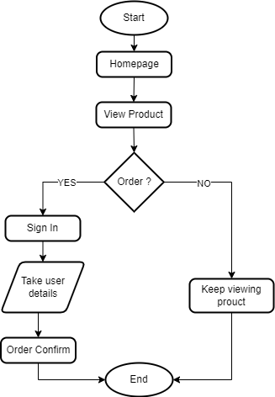
3.2 System Design 3.2.1 Flow Chart

Slide 13
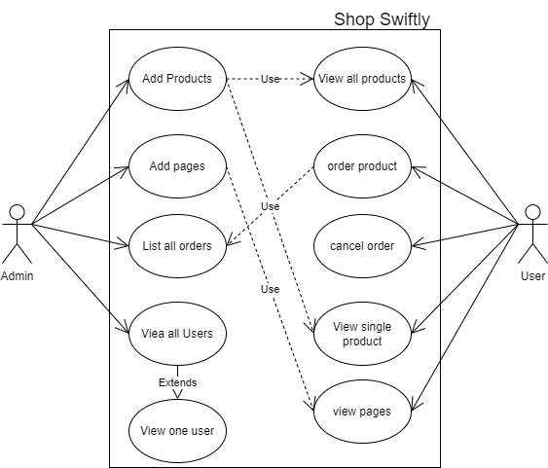
3.2.2 Use Case

Slide 14
3.2.3 Description of algorithms
Recommendation System
Search Algorithm

Slide 15
3.2.4 Programming Languages
FrontEnd
React
Backend
PHP
Database
phpMyAdmin

Slide 16
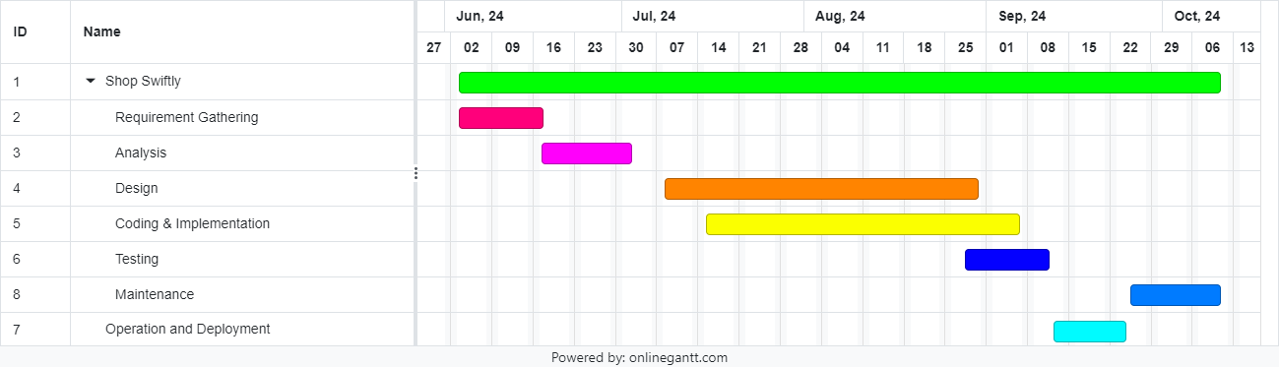
Chapter 4: Gantt chart

Slide 17
Chapter 5: Expected Outcome
After the completion of the project the CMS system is developed having features:
Adding Posts, pages, category, media, etc.
Adding users with roles and capabilities.
Adding YouTube videos
Compare two products

Slide 18
References
B. Hari, "Article cms bala hari : pulse : linkedin," 11 July 2023. [Online]. Available: https://www.linkedin.com/pulse/article-cms-bala-hari.
C. Morris, 03 November 2022. [Online]. Available: https://www.searchenginejournal.com/what-is-a-content-management-system-cms/468136/.
S. A. F. C. Scott Robinson, "Content Management: TechTarget," April 2024. [Online]. Available: https://www.techtarget.com/searchcontentmanagement/definition/content-management-system-CMS#:~:text=A%20CMS%20provides%20a%20graphical,content%20delivery%20application%20(CDA)..
A. Volle, "Computers : Technology : Britannica," 05 June 2024. [Online]. Available: https://www.britannica.com/technology/content-management-system.

